Slide 1



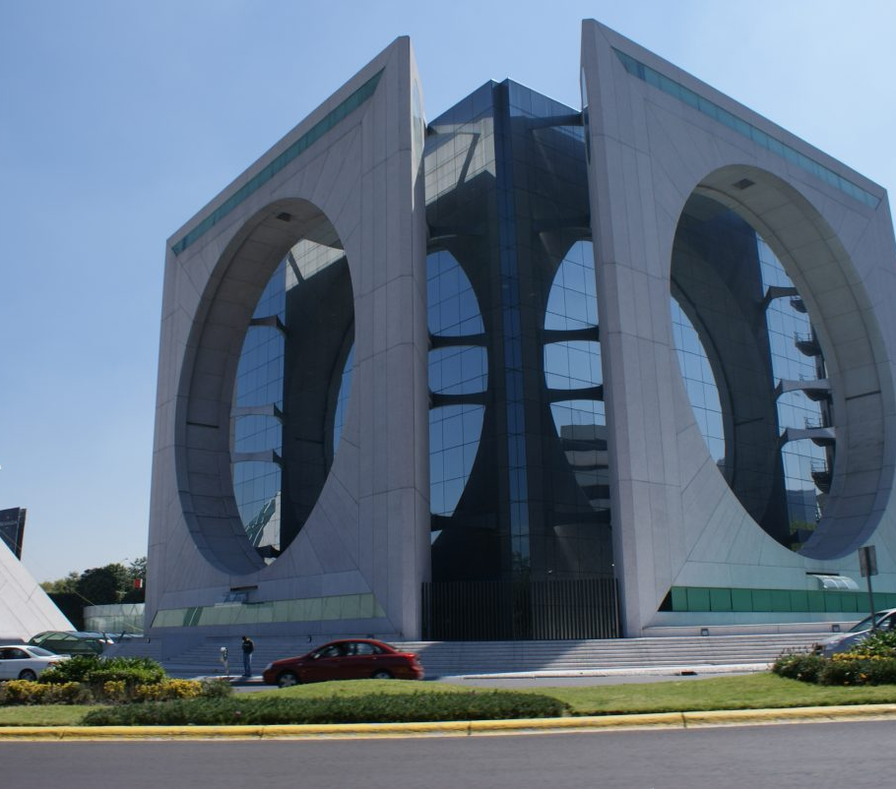
Technical Report:
Predicting Charging Demand
EV Data Intelligence Lead

Slide 2
Arc by Element: Case Study
Objective
The primary objective of this analysis is to predict EV charging demand and optimize the placement of EV stations to enhance infrastructure coverage and utilization.
Key deliverables include:
Identifying underserved areas: From the existing dataset considering station density and proximity to urban centers
Proposing new station locations: Based on underserved locations having introduced additional features

Slide 3
Arc by Element: Case Study
Data Sources: Not Considered
Comprehensive data sources was provided for this analysis as below. However, some sources often require sophisticated means to extract the data which was out of scope for this case study. Limitations are highlighted in red below
Open Charge Map: Global registry of EV charging locations, including station usage metrics.
Requires use of API to fetch data. API has a maximum result limit of 100 rows. Alternative data source was considered.
European Alternative Fuels Observatory (EAFO) : Provides EV charging data across Europe, with station locations, usage types, and market statistics.
Charging stations outside of the US were not considered.
OpenWeather API : Use for basic weather data to add depth to your analysis.
Requires use of API to fetch data. API has a maximum result limit of 100 rows. Alternative data source was considered.
National Renewable Energy Laboratory (NREL) : Electric Load Data Provides historical and real-time energy load data, which can offer insights into peak electricity consumption periods for EV charging.
Data was not found in a consumable format.

Slide 4
Arc by Element: Case Study
Data Sources: Considered
Comprehensive data sources was provided for this analysis as below. However, some sources often require sophisticated means to extract the data which was out of scope for this case study. Examples include
U.S. Department of Energy - Alternative Fuels Data Center (AFDC): Data on EV charging stations across the U.S., with station locations and some usage statistics.
U.S. Census Bureau : Population and Demographic Data Provides population density, household income, and urban/rural area data, which can influence EV adoption and charging demand.

Slide 5
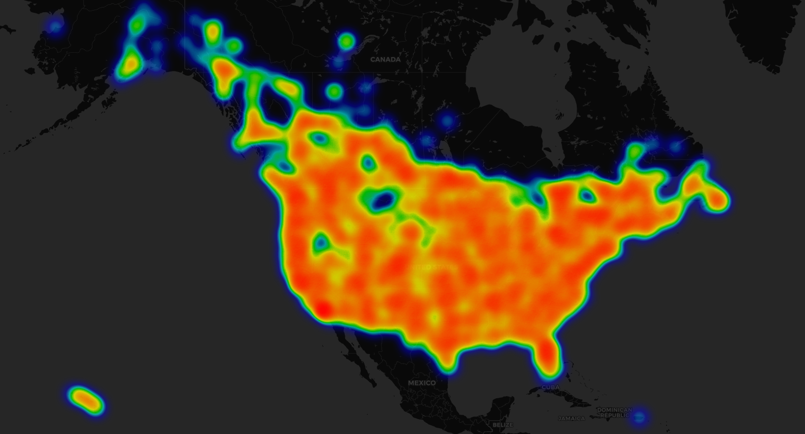
Arc by Element: Case Study
Exploratory Analysis: HeatMap of Stations

Slide 6
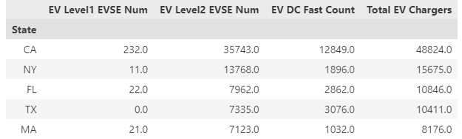
Arc by Element: Case Study
Exploratory Analysis:
Exploratory Analysis was carried out to understand the data:
Identified California as the state with the highest number of EV stations, contributing 25% of all stations in the US.
Hotels, car dealerships, parking garages are the most common facility types where stations are located.
J1772 connection types represent 90% of all connection types ~ 93%
The first station was opened 30th August 1995 in the Los Angeles Convention Center
States with most chargers across level1, level2, DCFC and total: California leads the way in electric station infrastructure. Not only do they have the most EV chargers, but they also have the most level 1, level 2, and DCFC.

Slide 7
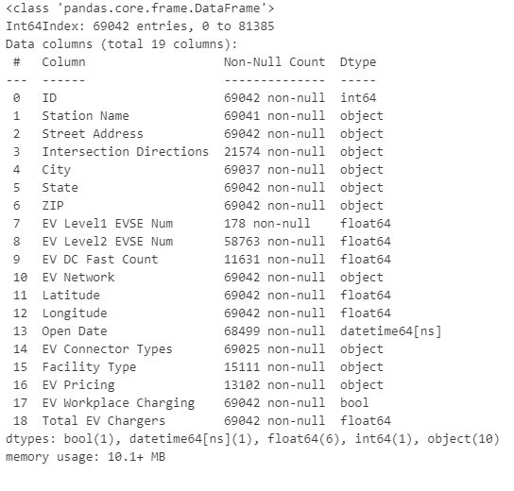
Arc by Element: Case Study
Treating of Missing Values:
Features with missing values:
EV Level1 EVSE Num, EV Level2 EVSE Num, EV DC Fast Count, Facility Type, EV Pricing all have considerable null values.
We will fill missing values using two approaches:
Fill nulls in EV Level1 EVSE Num, EV Level2 EVSE Num, EV DC Fast Count with zero.
Use a Random Forest Classifier model to predict the null values for Facility type column.
Hotels, car dealerships, parking garages are the most common facility types where stations are located.
We can use the station name, street address, intersection directions and city to predict facility type.

Slide 8
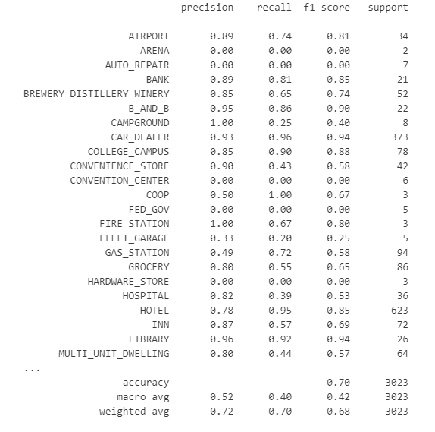
Arc by Element: Case Study
Random Forest Classifier Model: Result
Interpreting the results for each class:
Accuracy (0.68): This is the overall percentage of correct predictions. It tells us how often the model correctly predicted the class across all instances. The accuracy is reasonable but considering the class imbalance and skewed performance for certain classes, accuracy might not be the best metric for evaluating performance here.
Macro Average:
Precision: 0.53: The average precision across all classes.
Recall: 0.40: The average recall across all classes.
F1-Score: 0.43: The average F1-score across all classes. These averages are calculated without accounting for class imbalance, meaning each class is weighted equally. The macro average is generally lower when there are many underperforming or underrepresented classes.
Weighted Average:
Precision: 0.71: The weighted precision, which accounts for the number of instances in each class, is higher than the macro average. This suggests that the model performs better on the more frequent classes.
Recall: 0.69: Similarly, the recall is higher in the weighted average, again reflecting better performance on more frequent classes.
F1-Score: 0.68: The weighted F1-score also reflects this better performance for larger classes.

Slide 9
Arc by Element: Case Study
Random Forest Classifier Model: Result Cont.
Reasons for Low Performance in Some Classes :
Class Imbalance: Many of the categories (e.g., "FUEL_RESELLER", "CARWASH", "RETAIL") have very few samples or are very difficult for the model to distinguish, which could explain why they have very low precision, recall, and F1-scores.
Underrepresented Classes: Some classes have only one or a few instances (e.g., "STADIUM" with 1 instance, "FED_GOV" with 3), making it difficult for the model to learn these classes effectively.
Misclassification: The model might be confusing certain classes, especially if they are similar or have overlapping features.
Suggestions for Improving Performance
We won't be improving this model as the facility type is not a key feature in determining EV station location in this use case.
We used the model to treat missing values in the facility column for exploration purposes and will proceed with other aspect of this analysis.

Slide 10
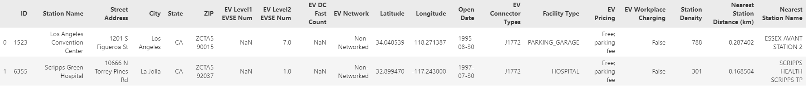
Arc by Element: Case Study
Data Preparation: Adding New Features
Calculating station density and distance to closest stationed DBSCAN clustering to group underserved locations:
Methodology
Using BallTree approach to calculate station density
Haversine Metric: The haversine formula calculates distances on a sphere. By using radians, it avoids the complexity of geodesic distance calculations.
Radius Filtering: Only stations within the given radius (e.g., 10 km) are considered for density calculations
Expected New Features
Station Density: The number of neighboring stations (excluding the station itself)
Nearest Station Distance(km): Considering all neighboring stations
Nearest Station Name: Identifies new stations

Slide 11
Arc by Element: Case Study
Data Preparation: Adding New Features cont.
Calculating Urban Proximity: Focus on California to reduce computational demand :
Methodology
Load urban centers.csv
Filter only urban centers in california
Haversine Metric: The haversine formula calculates distances on a sphere. By using radians, it avoids the complexity of geodesic distance calculations.
Store results in california_station_df
Expected New Features
Distance to Nearest Urban Center (km): Considering all neighboring urban center
Nearest Urban Center Name: Identifies urban center

Slide 12
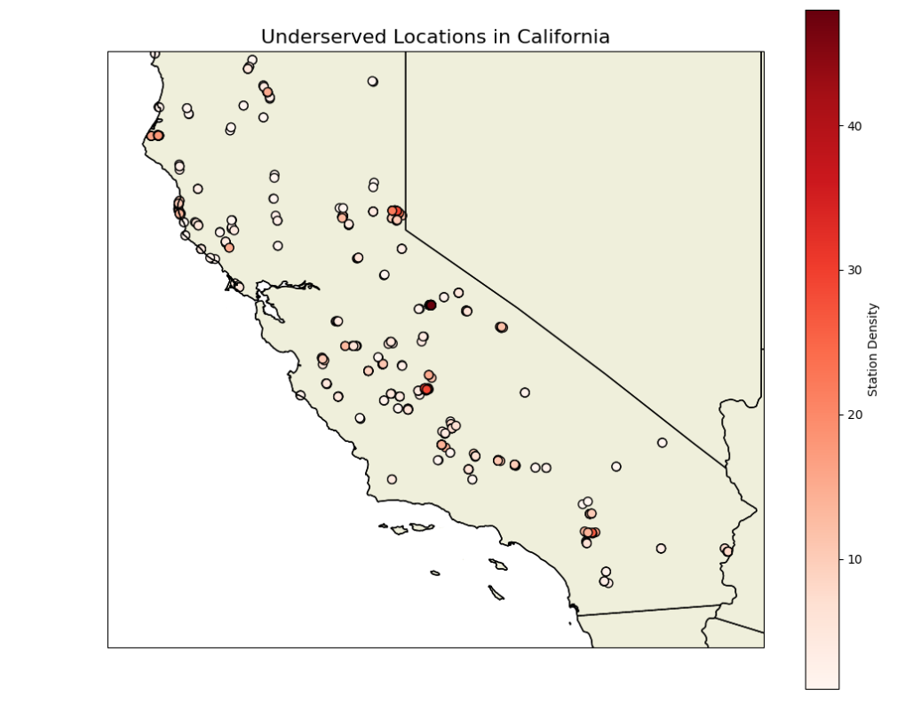
Arc by Element: Case Study
Using DBSCAN to Identify Underserved Areas
Methodology : Identify underserved locations based on both station density and urban center distance
Locations with station density below the 20th percentile are marked as underserved.
Urban centers more than 20 km from the nearest urban center are also marked.
Identified 590 underserved locations in California
Interactive Map of Underserved Locations

Slide 13
Arc by Element: Case Study
Measuring Accuracy of the Clustering:
Accuracy for a Clustering-Based Model : Since this is an unsupervised clustering model (e.g., DBSCAN), accuracy can’t be measured directly as there is no predefined "ground truth." However, we can evaluate the model using two approaches:
Coverage metrics : Meaning how many underserved locations was identified compared to the entire population
Silhouette score : Using DBSCAN internal evaluation to measure how well clusters are defined (compact and well-separated). Values range from -1 to 1 (higher is better)
Based on the above, the percentage of underserved location is 3.56% and the Silhouette score is 0.88 – which is good. We can attempt to improve the model by adding new features.
Adding new dataset: Population Density, Housing Density, Mean Income and Land Area to merge with existing dataset :
Create new features:
Station Count per ZIP : Count the number of stations in each ZIP to measure infrastructure density.
Population per Station : Calculate the ratio of total population density to the number of stations in a ZIP
Housing Units per Station : Measure housing density relative to the number of stations in a ZIP

Slide 14
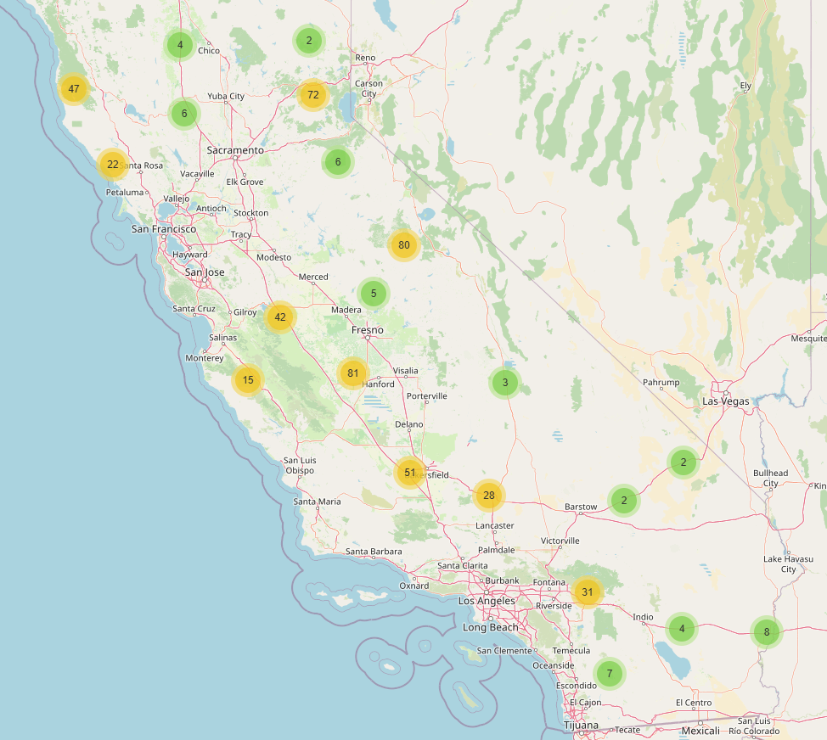
Arc by Element: Case Study
DBSCAN : Key Findings
Key Findings :
Urban areas like Los Angeles and the San Francisco Bay Area have high station density.
Remote areas show sparse station coverage.
Higher station density is correlated with high-income and urban areas.
California has 3.56% underserved locations
Majority are in rural Central California and low-income zones in Southern California.
Recommendations : Priority Locations for New Stations
ZIP 92345: High Population per Station.
ZIP 93536: High Housing Density per Station.
ZIP 90032: Far from Urban Center.
Optimization Insights:
Target underserved clusters like Central Valley and Inland Empire.
Focus on public facilities such as shopping centers, parking garages, and workplaces.
Policy and Planning Suggestions:
Incentivize installations in rural areas with tax benefits or grants.
Partner with retail properties to improve accessibility.
Expand DC Fast Charging networks for long-distance travel

Slide 15
Arc by Element: Case Study
Conclusion
This analysis highlights key underserved areas in California's EV infrastructure and provides actionable recommendations to optimize EV station placement.
By targeting the proposed locations, planners can enhance EV adoption and improve infrastructure equity.

